Slide 1
>> SLIDE / DIAPOSITIVA 1
IL-NET National Training and Technical Assistance Center for Independent Living
ILRU T&TA Center

Slide 2
>> SLIDE / DIAPOSITIVA 2 Our Presenter
Katie Blank, Senior Manager-IL Dept.
Access Living-115 W. Chicago Ave. Chicago, IL 60654
Kblank@accessliving.org
312-640-2103

Slide 3
>> SLIDE / DIAPOSITIVA 3 What You Will Learn About Today
The start to end process of creating and maintaining a consumer file.
Information and Referral (I&R)-When a record is an I&R.
Consumer signature requirements for electronic files and when an individual is under 18 or has a guardian.
Explanation of an Independent Living Plan vs. a Goal.

Slide 4
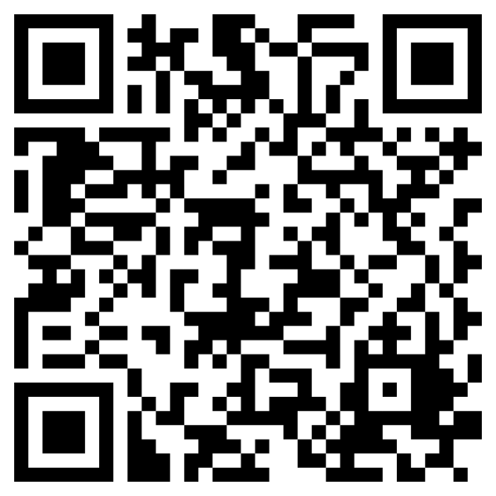
>> SLIDE / DIAPOSITIVA 4 Evaluation Survey
Your feedback on this webinar is important to us. At the end of the presentation, you will have the opportunity to complete a brief evaluation survey.
Evaluation Link: https://uthtmc.az1.qualtrics.com/jfe/form/SV_ewEcd7v7yPWKitU

Slide 5
>> SLIDE / DIAPOSITIVA 5 General Reminders
Accessibility
Captions can be accessed through Zoom. The link is in your agenda. A full transcript can be downloaded following the meeting.
Provide a visual description when introducing yourself
Share your pronouns
Open to Learn
The group contains all levels of experience and backgrounds.
This is a learning environment, and all questions are appropriate and expected.

Slide 6
Slide 6 Other things to remember…
Please note that plain language comments may differ from the specific law or regulations. Look at the law and regulations to be sure you understand. IL Network:
*CIL – Center for Independent Living
*ILP-Independent Living Plan
*CAP-Client Assistance Program
*CIF-Consumer Information File
*I&R-Information and Referral
To download a copy of common IL acronyms, please visit the ILRU website linked here.

Slide 7
Consumer Information File (CIF)
Consumer Information File (CIF)-The record maintained for each individual receiving services from a CIL.
All consumers need a Consumer Information File, except when the contact is information and referral.
This file may be paper or electronic or a combination, depending on your center’s policies.
Consumer Control: Guided principles of CILS
Follow your CILs policies-ensuring you are staying in compliance with federal statues, regulations, and terms/conditions of the grants awarded to your CIL

Slide 8
Information and referral (I&R)
Core service-coordination starts with I&R
An I&R is when someone reaches out to your agency for resources, information, or services.
Refer internally to services at your CIL or externally to resources.
Record the time, date, and information collected. *Refer to your CILs policies in case additional information is required.
A CIF does not have to be created for an individual receiving I&R assistance.
I&R can be provided to individuals that do not have a disability -- agencies, consumers, family members, etc.

Slide 9
Determine Eligibility
Eligible For Services:
The individual has to:
Have a significant disability, not limited to a certain type of disability or circumstance.
Self-disclose or request services
Document eligibility in CIF and on the intake form or a separate eligibility determination form (dated and signed by the individual and/or appropriate CIL staff)
Refer to your CILs policies for additional eligibility requirements per program.
Notes:
Significant disability means: an individual with a severe physical or mental impairment whose ability to function independently in the family or community or whose ability to obtain, maintain, or advance in employment is substantially limited and for whom the delivery of independent living services will improve the ability to function, continue functioning, or move toward functioning independently in the family or community or to continue in employment, respectively.8

Slide 10
Client Information Files Include:
Consumer’s full name, mailing address, e-mail or telephone number, age, gender, race/ethnicity, and type of disability.
Documentation of eligibility/ineligibility.
Services requested by and provided to the consumer.
Information about each contact with the consumer.
Information about accommodations available.
An ILP or ILP waiver, goals with action steps, and goals achieved.
Release of information forms (if youth, the only form that a parent must sign rather than the youth)
Notification about the Client Assistance Program (CAP).

Slide 11
Independent Living Plan (ILP) vs. Goals
After determining an individual is eligible:
Consumers create an Independent Living Plan or Goals with the appropriate IL staff.
If a consumer wants to create an ILP, they will work with staff to identify:
An independent living goal
Action Steps
Target Date
Consumers have the right to waive the develop of an ILP.

Slide 12
Independent Living Plan (ILP) vs. Goals Continued
If a consumer does not want to create an ILP:
Consumers must sign a waiver stating that an ILP is unnecessary.
Consumer still needs to identify goals and actions steps with the CIL staff.
In both situations, the consumer needs to sign the paperwork.
Signatures may be hard copy or electronic based on your center’s policies and capacity.

Slide 13
Goals and Action Steps
CIL staff and the consumer develop goals and action steps together
Consumer’s are encouraged to take the lead
Goals help consumers increase their independence, leadership, empowerment, self-worth, self-esteem, productivity, and advocacy.
Goals are what the consumer wants to accomplish, and they have an end date. Services and action steps are a way to achieve a consumer’s goal.
Consumers can create multiple goals and receive multiple services from the CIL.
Notes:
***Making choices and decisions while creating their goals will empower consumers, and ensure that their needs are considered and addressed. In addition, if consumers are “calling the shots,” they will experience “ownership” of the IL planning process and will be more motivated to complete needed activities. *****Reported completed goals also demonstrate to funders that the services provided by CILs are making a difference in the lives of individuals with disabilities and in their communities.

Slide 14
Goal and Action Step Example:
Significant Life Area: Vocational
Goal: I want to become employed within the next three months so I can have my own money.
Action Steps:
1. I will identify my interests by discussing them with my IL Specialist and making a list.
2. I will identify my marketable skills by:
Thinking about which jobs I have had in the past and making a list to discuss with my IL Specialist.
Contacting the Vocational Rehabilitation agency to determine if a VR counselor can assist me.

Slide 15
Client Assistants Program (CAP)
CAP informs people with disabilities about services and assists when a person is experiencing difficulties receiving services funded under the Rehabilitation Act.
All CILs must inform individuals seeking or receiving services about the Client Assistance Program and how to contact the CAP.
The CIL must include documentation of this notification as part of the CIF.
The consumer may complain to the CAP if they feel the CIL is not treating them fairly.

Slide 16
Release of Information Forms
A Release of Information is used to obtain or share information that assists CILS in providing services to a consumer, such as:
Photos, medical records, IEP/504 plans, CIL annual Audit, housing, etc.
Create and sign separate Release of Information forms for each entity the CIL is requesting information from or providing information to.
There may not be a need to release information in some cases.
This has legal standing, so the legally responsible person must sign.

Slide 17
Maintaining a Client Information File
Document notes (narrative entries) in the CIF for each contact with the consumer.
Narratives should show the CIL’s role in developing and achieving the consumer’s goal.
Review forms and information in the CIF to ensure information is up-to-date.
Review the ILP with the consumer-Annual reviews are required.
The CIF should be closed, and end dates added, if joint activities are not occurring.
Closure dates are determined by the CIL.
The record may be opened again any time.

Slide 18
Closing the Client Information File
Close active files when the consumer: achieves goals, requests to discontinue services, moves and doesn’t provide updated contact information, or is deceased.
Steps to closing a file:
Notify the consumer in writing that the CIF will be closed.
Add a closure note and a signed/dated copy of the closure letter in the CIF.
Add an end date to the ILP or Goal.
Add an end date and reason for closure to the CIF.
Refer consumer to other programs or agencies, as needed.
Move the file to an inactive status and archive the file.

Slide 19
Electronic Files
The CIF can be created and maintained either electronically or in written form.
A form of electronic paperwork can be done in DocuSign.
Electronic signatures are allowed.
Consumer can use any method to sign the documents, as long as they initiate the process.
Some options for signing: signature pad, touch screen, pre-created signature, or with the use of a mouse and pointer.
Signatures can be obtained by:
Emailing paperwork to individual to complete and return.
In person electronic signature.

Slide 20
Signatures
Refer to your CILS policies.
Youth 18-years-old and under, and adults with guardians, can sign paperwork; except for legal documents (such as, release forms).
Consumers 18-years and older, that are their own guardian, can sign all documents.

Slide 21
Slide 21 Questions?
What are you curious about?
What needs clarification?

Slide 22
Resources
https://www.ilru.org/sites/default/files/Consumer%20Information%20Files%20Manual_2020.pdf
Sample forms and policies from various CILs:
https://www.ilru.org/resources-consumer-information-files

Slide 23
>> SLIDE / DIAPOSITIVA 23 Evaluation Survey
Your feedback on this webinar is important to us. At the end of the presentation, you will have the opportunity to complete a brief evaluation survey.
Evaluation Link: https://uthtmc.az1.qualtrics.com/jfe/form/SV_ewEcd7v7yPWKitU

Slide 24
>> SLIDE / DIAPOSITIVA 24 Training Presented by IL-NET:
The IL-NET National Training and Technical Assistance (T&TA) Center for Independent Living is operated by ILRU (Independent Living Research Utilization) in partnership with the National Council on Independent Living, the Association of Programs for Rural Independent Living, the University of Montana Rural Institute/RTC Rural and a consultant network of subject-matter experts.
The IL-NET T&TA Center provides training and technical assistance to centers for independent living, statewide independent living councils, and designated state entities.

Slide 25
Slide 25 IL-NET (CIL-NET and SILC-NET) Attribution
Support for the development of this training was provided by the Department of Health and Human Services, Administration for Community Living under grant numbers 90ILTA0001 and 90ISTA0001. No official endorsement of the Department of Health and Human Services should be inferred. Permission is granted for duplication of any portion of this PowerPoint presentation, providing that the following credit is given to the project: Developed as part of the IL-NET, an ILRU/NCIL/APRIL National Training and Technical Assistance project.

