Slide 1
Slide 1 Independent Living Research Utilization

Slide 2
Slide 2 An Introduction to Accessibility in the Built Environment
October 19, 2023
Presenter:
Mary Reaves, MRC

Slide 3
Slide 3 Today's Presenter
Mary Reaves
She/Her/Hers
Director of Community Access
Image of Mary Reaves smiling.

Slide 4
Slide 4 Training Objectives
Quick Intro: Americans with Disabilities Act
Title II and Title III
2010 Standards for Accessible Design

Slide 5
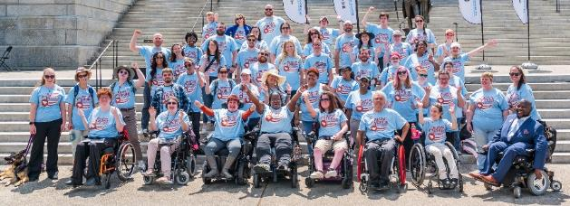
Slide 5 Able SC’s Mission & Vision
Mission​
We are an organization of people with disabilities leading the charge to: ​
Equip people with disabilities with tools to foster pride and to direct their own lives;​
Educate the community to challenge stereotypes and eliminate barriers; and​
Advocate for access, equity, and inclusion at the individual, local, state, and national level. ​
Vision​
A South Carolina that is a national model of equity and inclusion for all people with disabilities.​
Image of the Able SC team at Advocacy Day in front of the SC State House

Slide 6
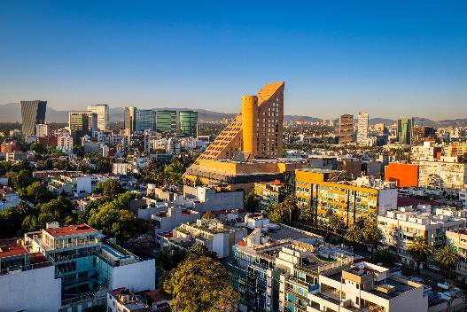
Slide 6 Americans with Disabilities Act (ADA)
Title II – Public Services
State and local government services, programs and activities must be accessible

Slide 7
Slide 7 ADA: Title II
Title II prohibits disability discrimination in state, county, and city government services.
All activities, services, and programs are covered under the ADA, including employment, public meetings, court activities, and programs of police, fire, voting, emergency management, and parks and recreation departments.
Website services must also be made accessible.
Title II states:
“ No qualified individual with a disability shall, by reason of such disability, be excluded from participation in or be denied the benefits of the services, programs, or activities of a public entity, or be subjected to discrimination by any such entity”
Notes:
As defined, the term "public entity" does not include the Federal Government. Title II, therefore, does not apply to the Federal Government, which is covered by sections 501 and 504 of the Rehabilitation Act of 1973.
In some cases it is difficult to determine whether a particular entity that is providing a public service, such as a library, museum, or volunteer fire department, is in fact a public entity. Where an entity appears to have both public and private features, it is necessary to examine the relationship between the entity and the governmental unit to determine whether the entity is public or private. Factors to be considered in this determination include --
1) Whether the entity is operated with public funds; 2) Whether the entity's employees are considered government employees;
3) Whether the entity receives significant assistance from the government by provision of property or equipment; and
4) Whether the entity is governed by an independent board selected by members of a private organization or a board elected by the voters or appointed by elected officials.

Slide 8
Slide 8 Title II Administrative Requirements
Public Entities are required to:
adopt and distribute a public notice about the relevant provisions of the ADA to all people who may be interested in its programs, activities, and services.
If a state or local government has 50 employees or more, it is required to: Adopt and distribute a public notice about the relevant provisions of the ADA to all persons who may be interested in its programs, activities, and services.
Designate at least one employee responsible for coordinating compliance with the ADA and investigating ADA complaints;
Develop and publish grievance procedures to provide fair and prompt resolution of complaints under Title II of the ADA at the local level.
Develop a transition plan if structural changes are necessary for achieving program accessibility.
28 C.F.R. pt. 35, § 35.107(a)

Slide 9
Slide 9 ADA: Title III
Title III prohibits disability discrimination from “Public Accommodations”
Anything open to the general public (i.e. grocery store, library, legal office, school, hospital)
Website services must also be made accessible.
Requires barrier removal when “readily achievable”
Effective Communication (ASL, captions, etc)
Department of Justice (DoJ)

Slide 10
Slide 10 Built Before January 26, 1992
If there is an architectural barrier to accessibility in a pre-ADA facility, you may remove the barrier using the 2010 ADA Standards for Accessible Design or UFAS as a guide, or you may choose to make the program, service, or activity located in the building accessible by providing “program access.”
Program access allows you to move the program to an accessible location, or use some way other than making all architectural changes to make the program, service, or activity readily accessible to and usable by individuals with disabilities.
C.F.R. § 35.151
Notes:
There is no such thing as being grandfathered in when it comes to program accessibility!
Here are some examples:
Example: A small town with few public buildings operates a museum featuring the history of the area. The museum is in a two story building built in 1970, which has no elevator. The town may either install an elevator or find other ways to make the exhibits accessible to people with mobility disabilities. One program access solution in this case might be to make a video of the second floor exhibits for people to watch on the first floor.
There are many ways to make a program, service, or activity accessible other than through architectural modifications. Keep in mind, however, that sometimes making architectural changes is the best solution financially or administratively, or because it furthers the ADA’s goal of integration.
Common Problems with New Construction and Alterations
It is very common for architects and contractors to follow only their local building codes, which may not provide the same degree of accessibility to persons with disabilities. Compliance with local building codes does not ensure compliance with the ADA.
If your buildings are currently not accessible, then you will need to create a transition plan to show how you plan on becoming accessible when any new construction/renovation occurs.

Slide 11
Slide 11 Additional Relevant Laws
Architectural Barriers Act (ABA)
Rehabilitation Act of 1973
Sections 504 + 508
Fair Housing Act
Air Carrier Access Act
Image of Law books section in library showing multiple rows of red law books.

Slide 12
Slide 12 Examples of Barriers to Accessibility
Architectural
A building has just one entrance that is up a flight of stairs and has no ramp.
The door to the only public restroom in a building is 28 inches wide.
Effective Communication
No assistive listening system for public meetings by a County Council.
A County’s website that cannot be accessed by people who are blind using screen reader software or those with low vision using text enlargement software.
Policies and Procedures (Administrative Requirements)
Requiring a driver’s license to obtain a library card from the public library.
A “No Animals” rule (without an exception for service animals) to an office.
Notes:
Doors must be 32 inches wide with a clear opening
** All public areas should be accessible to provide full access to a programs/services.

Slide 13
Slide 13 Architectural Accessibility
All facilities designed, constructed, or altered by, on behalf of, or for the use of a public entity must be readily accessible and usable by individuals with disabilities, if the construction or alteration is begun after January 26, 1992.
What is "readily accessible and usable?“
This means that the facility must be designed, constructed, or altered in strict compliance with a design standard. The regulation gives a choice of two standards that may be used- UFAS or ADAAG.
Notes:
Uniform Federal Accessibility Standards (UFAS) or the Americans with Disabilities Act Accessibility Guidelines for Buildings and Facilities (ADAAG),
New and altered facilities must be built in compliance with the ADA Standards or UFAS regardless of what, if any, programs are located in them. Even if new or altered facilities are not open to the public, they must be accessible to people with disabilities.

Slide 14
Slide 14 Dates for Compliance
Compliance Date for New Construction or Alteration | Applicable Standards
Before September 15, 2010 | 1991 Standards or UFAS
On or after September 12, 2010, and before March 15, 2012 | 1991 Standards, UFAS, or 2010 Standards
On or after March 15, 2012 | 2010 Standards
Anything that is currently found to be out of compliance with the relevant standards should be included in a transition plan for a future alteration in compliance with the 2010 Standards
Notes:
Which standards should you use in each of the following situations?
County Courthouse was built in 1978 and is still in use in its original state.
City Hall was built in 1994.
City Hall’s parking lot was completely repaved in 2013.
The Parks Department Office was built in 1996 and had significant renovation in 2011.
Local School District Office was built in 2013.
A new city park including a playground was built in 2011.

Slide 15
Slide 15 Parking
Image of a blue parking sign with 5 arrows pointing down and multiple, confusing directions

Slide 16
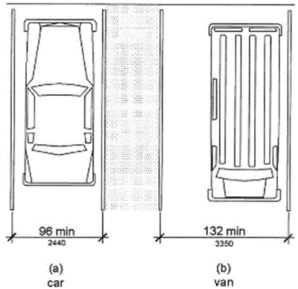
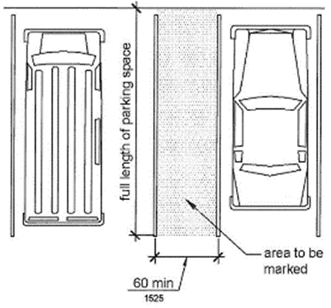
Slide 16 Accessible Parking Spaces
Diagram of Parking Space Size
Diagram of Access Aisle

Slide 17
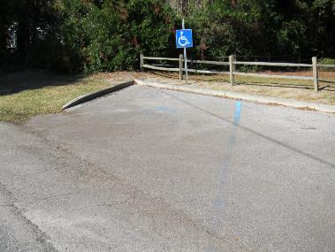
Slide 17 Accessible Parking Spaces, cont.
2 images showing accessible parking spaces-1st Image showing access aisle;
2nd image- parking space with faded lines

Slide 18
Slide 18 Accessible Routes
206.2.1 Site Arrival Points. At least one accessible route shall be provided within the site from accessible parking spaces and accessible passenger loading zones; public streets and sidewalks; and public transportation stopes to the accessible building or facility entrance they serve.
206.2.2 Within a Site. At least one accessible route shall accessible elements, and accessible spaces that are on the same site.
Image of a bus stop that does not have a curb cut and is inaccessible despite being on a paved path of travel - there is no access to the road

Slide 19
Slide 19 Restrooms

Slide 20
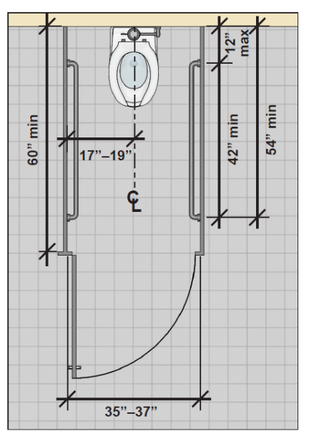
Slide 20 Toilet Stalls
Dimensions of the ambulatory stall in the diagram above
60” min depth
35”-37” width
Center line of toilet 17”-19” from side wall
Grab bars must be simultaneously in reach on either side, at max 12” from back wall and min 42” if so, or 54” min if mounted at back wall

Slide 21
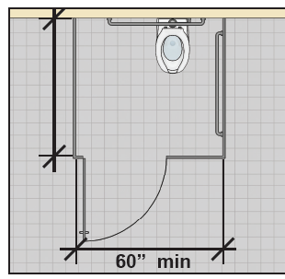
Slide 21 Toilet Stalls, cont.
Referring to the diagram and depth/length of a stall - 59” min
(greater than 65” if no toe clearance at front partition)
Referring to the diagram and width of a stall - (greater than 66” of no toe clearance at a side partition

Slide 22
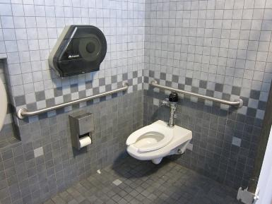
Toilet Stalls, cont.
Photo of an accessible stall showing toilet paper mounted above the grab bar very high and another below to attempt compliance, toilet mounted at height and distance but with flush mechanism on the wall side instead of the open side.

Slide 23
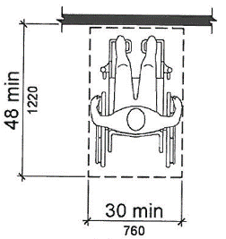
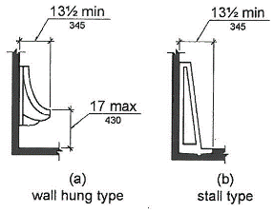
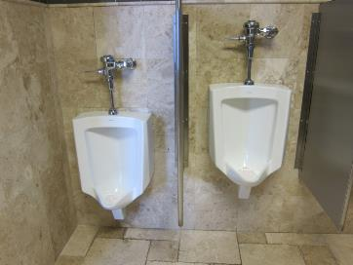
Urinals
Urinal Height & Depth
Wall hung - rim min 131/2” from wall, 17” from floor
Stall type - rim 131/2” min from wall
Clear Floor Space –48” min depth and 30” min width at each urinal
Notes:
Urinals are only required to be at height if there is more than one present in the bathroom

Slide 24
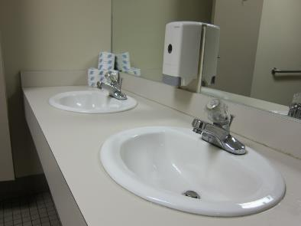
Slide 24 Lavatories
309.4 Operation. Operable parts shall be operable with one hand and shall not require tight grasping, pinching, or twisting of the wrist. The force required to activate operable parts shall be 5 pounds (22.2N) maximum.

Slide 25
Slide 25 Lavatories, cont.
606.5 Exposed Pipes and Surfaces. Water supply and drainpipes under lavatories and sinks shall be insulated or otherwise configured to protect against contact. There shall be no sharp or abrasive surfaces under lavatories and sinks.

Slide 26
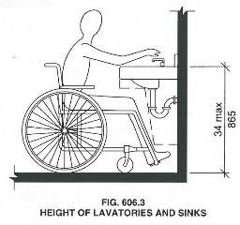
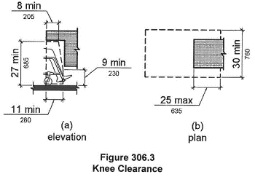
Slide 26 Lavatories – Cont.
Height and Knee/Toe Clearance for Lavatories and Sinks
Height of sink shall be 34” max
8” min knee clearance depth and 27” min height
11” min depth and 9” min height for toe clearance

Slide 27
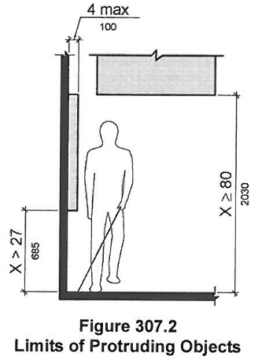
Slide 27 Protruding Objects
Image of objects protruding into the path of travel: Wide hallway that includes letter tray, AED machine, and fire extinguisher. Only the fire extinguisher is compliant as it is recessed into the wall

Slide 28
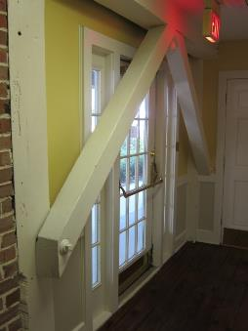
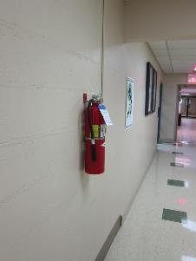
Slide 28 Protruding Objects
2 images of objects protruding into the path of travel
Wooden A-frames arching over an exit door that cuts into the corners of the path of travel
Hallway with a fire extinguisher mounted directly onto the wall in the path of travel

Slide 29
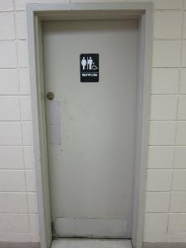
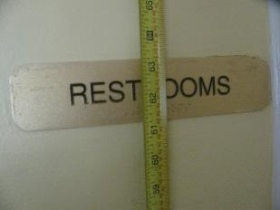
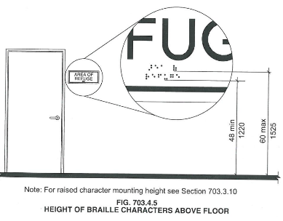
Slide 29 Signs
3 Images displaying signage examples
Wall mounted sign on latch side of door at appropriate height and size
Sign mounted on a push side door
Restroom sign close-up showing Braille is mounted at 61.5” from the floor

Slide 30
Slide 30 Resources
US Access Board - access-board.gov
ADA Information and Technical Assistance - ada.gov
Types of Auxiliary Aides for Effective Communication - adata.org
Web Content Accessibility Guidelines (WCAG) – Information on digital accessibility
Title II and the ADA Fact Sheet - able-sc.org

Slide 31
Slide 31 More Resources
Service Animals Fact Sheet - ada.gov
Plain Language Guidelines – plainlanguage.gov
Learn about the ADA - adata.org
Questions about the ADA - ada.gov
Disability Impacts All of Us – cdc.gov

Slide 32
Slide 32 Able Access
Architectural Assessments
Digital Accessibility testing and training (web, documents, social media)
Policy and Procedure Review
Job-site assessments and recommendations

Slide 33
Slide 33 Contact Us
Email: info@able-sc.org
Phone: 803-779-5121
TTY: 803-779-0949
Columbia, SC Office: 720 Gracern Rd. Suite 106
Greenville, SC Office: 135 Edinburgh Ct. Suite 101
Join Email List: Text ABLESC to 72572
Social Media:​
Facebook: @AbleSC​
Twitter: @able_sc​
Instagram: @able_sc​
LinkedIn: Able South Carolina​
YouTube: Able South Carolina​

Slide 34
Slide 34 IL-NET (CIL-NET and SILC-NET) Attribution
Support for the development of this training was provided by the Department of Health and Human Services, Administration for Community Living under grant numbers 90ILTA0001 and 90ISTA0001. No official endorsement of the Department of Health and Human Services should be inferred. Permission is granted for duplication of any portion of this PowerPoint presentation, providing that the following credit is given to the project: Developed as part of the IL-NET, an ILRU/NCIL/APRIL National Training and Technical Assistance project.

